Slide 1
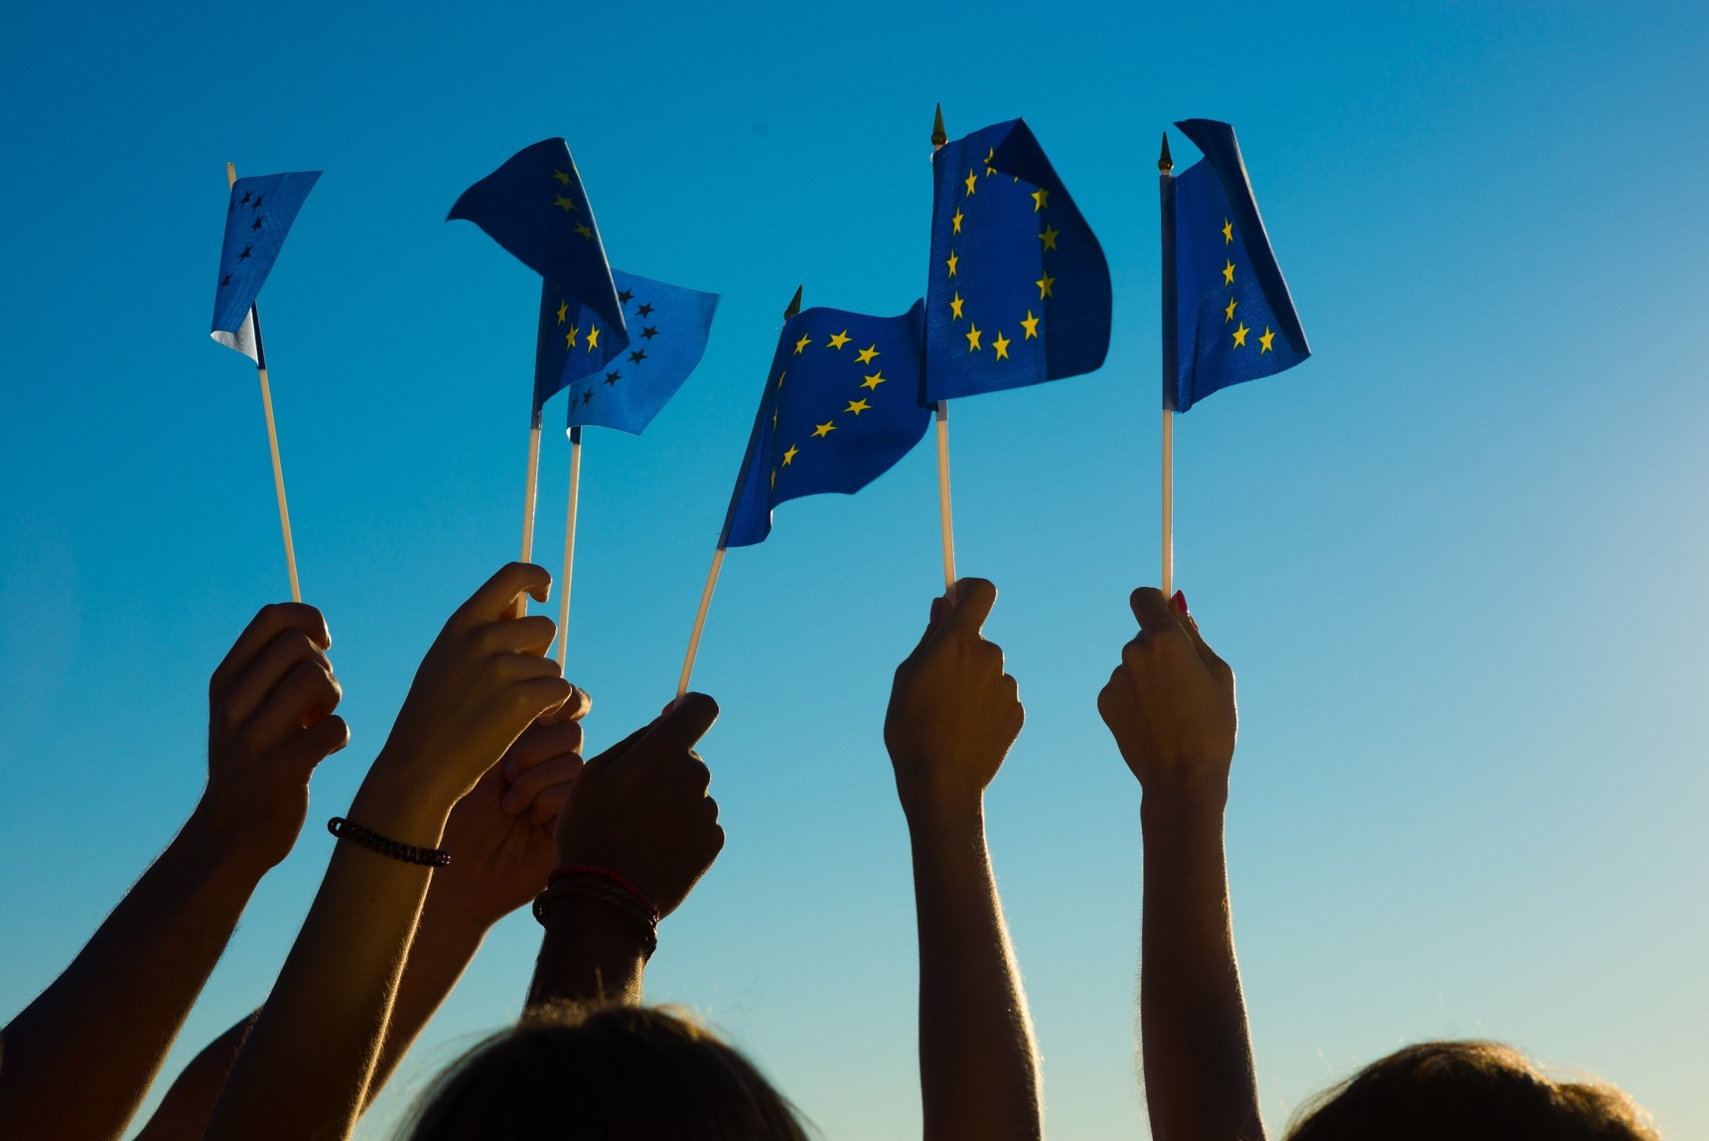
EIGE ‘s study to support the
PT Presidency of the Council:
Socio-economic consequences of the COVID-19 crisis
EUROPEAN INSTITUTE FOR
GENDER EQUALITY
Dr. Lina Salanauskaite| 08.03.2021 |
PT Presidency webinar ‘Impacts of the COVID19 crisis on women’s lives.
Equality at the heart of recovery’

Slide 2
Review of emerging and latest evidence: where are we in and across the EU?
Impacts on the labour market
Gender differences in (un)employment and economic inactivity; most affected economic sectors and population groups.
Impacts on working arrangements
Gender differences in teleworking patterns; gender equality impacts of teleworking implementation across organisations.
Impacts on gender roles
Unpaid work distribution between women and men; emerging work-life balance issues from gender equality perspective.
Role of employment supporting factors
Social protection, recovery measures; gender balance of the COVID-19 crisis management groups.

Slide 3
Employment changes for women and men: what statistics for spring and summer 2020 tell
The first COVID-19 wave led to large declines in employment for both women (-2.2 mln jobs) and men (-2.6 mln jobs), but employment rebounded stronger for men than for women in the summer of 2020.
Age | Women |  | Men |  | Women |  | Men
 | 1st COVID wave/lockdown |  |  |  | Summer (partial) recovery
 | Employment Q2 2020 | Employment change (Q2: 2020-2019) | Employment Q2 2020 | Employment change (Q2: 2020-2019) | Employment Q3, 2020 | Employment change (Q2 – Q3, 2020) | Employment Q3, 2020 | Employment change (Q2 – Q3, 2020)
15-24 | 6.3 mln. | - 10.4% | 7.7 mln | -9.0% | 6.6 mln | +5.3% | 8.1 mln | +6.4%
25-49 | 53.0 mln. | - 3.0% | 61.9 mln | -3.2% | 53.1 mln | +0.3% | 62.3 mln | +0.7%
50-64 | 28.5 mln. | +0.7% | 33.0 mln | +0.8% | 28.7 mln | +0.7% | 33.5 mln | +1.4%
15-64 | 87.8 mln. | -2.4% | 102.5 mln | -2.4% | 88.5 mln | +0.8% | 103.9 mln | +1.4%
Source: Eurostat

Slide 4
Employment losses: intersectional perspective
The scale of employment losses is particularly worrying for the women, whose chances on the labour market were already extremely bleak before the pandemic.
Source: Eurostat

Slide 5
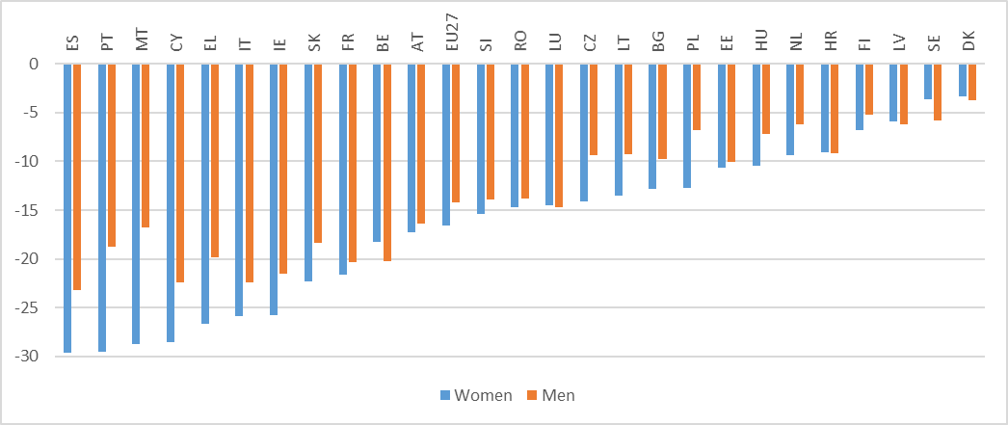
Countries’ perspective: aside of employment losses, total actual working hours reduced more for women than men
Change in index of total actual hours worked in the main job (pop 20-64) by country and gender, year-on-year change 2020-Q2, EU27 (index points)
*Index of total actual hours worked in the main job (2006 = 100); Data for DE are not available
Source: elaboration on Eurostat data (LFSI_AHW_Q)

Slide 6
Teleworking amid increased unpaid care work heightened work-life balance conflicts
A higher share of women than men are in teleworkable occupations: 45% compared to 30%
Telework and the work-life balance:
- Positive impacts: increase in flexibility and a potential of new gender dynamics in the distribution of unpaid care and domestic work.
- Negative impacts higher for women: interruptions, further reduced career progression, negative psychological effects, domestic violence.
Notes:
The gender difference in teleworkability relates in part to patterns of vertical and horizontal segregation, with men overrepresented in sectors with limited teleworkability potential (e.g. agriculture, mining, manufacturing and construction), and women overrepresented in occupations with a lower share of physical handling tasks (e.g. office-based, secretarial or administrative occupations).
Teleworking may create a new divide between those who can telework and those who cannot
Women’s disadvantage in digital skills increases with age
The COVID-19 crisis has particularly strained the financial situation of households with children, and especially single parents, who already showed high levels of risk of poverty before the COVID-19 outbreak

Slide 7
A higher share of women than men in teleworkable occupations, but …
The pandemic has shown the potential of a digital workforce, but teleworking amid increased unpaid care work heightened work-life balance conflicts:
  Rise in women’s share of unpaid work, despite some fathers’ increased participation
  Mothers with young children (0-5 years) face the hardest WLB challenge
  The division of childcare was more equitable in households where men were present: teleworked or had lost their jobs.
  Online schooling represents an additional form of unpaid care placing added pressure on the work-life balance of parents, and especially mothers.
  Gender gaps in teleworking patterns: mothers are more interrupted than fathers when they are teleworking.
Notes:
employed women with children under 12 years, spent around 54 hours/week in care, compared to 32 hours for employed men (Euforound, e-survey, July 2020).
E.g. UK survey: during lockdown mothers are interrupted 50% more often than fathers. This has an impact on productivity, with promotional consequences.

Slide 8
Women spent more hours than men on unpaid care during the first wave of the pandemic; parents could hardly rely on childcare services
Time spent by women and men on unpaid care activities in May/June 2020 and in 2016 (18+, hours per week), EU-27
Source: elaboration on Eurofound, “Living, working and COVID-19 dataset” and EQLS microdata (2016)

Slide 9
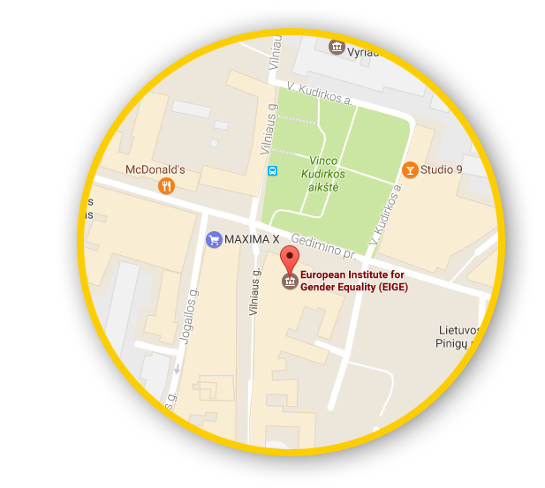






Let’s talk
Connect with us!
facebook.com/
eige.europa.eu
twitter.com/
eurogender
Gedimino pr. 16,
LT-01103 Vilnius,
Lithuania
eige.europa.eu
come in for a chat!
eige.europa.eu/
newsletter
eurogender.eige.
europa.eu
youtube.com/
user/eurogender
linkedin.com/
company/eige

